Slide 1
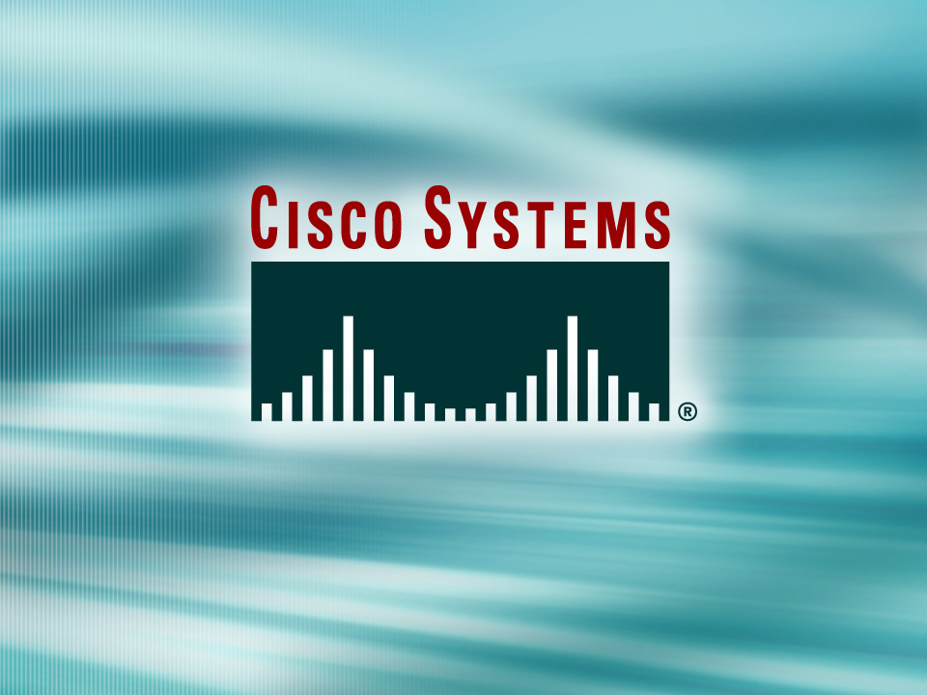
© 2002, Cisco Systems, Inc. All rights reserved.

Slide 2
Extending Switched Networks with VLANs
Module 4
Notes:
Purpose: This chapter introduces the Cisco IOS™ CLI on the Catalyst® 1900 switch and router.
Timing: This chapter should take about 2 hours to present.
Note: The Catalyst 1900 switch only has a subset of the router Cisco IOS commands available.
Contents:
Introduction to Cisco IOS. Explain to the student what is IOS?
Cisco Device startup procedures in general.
IOS configuration source.
General introduction to the IOS CLI.
Cat 1900 switch startup procedures.
Intro to Cat 1900 CLI. This part covers the basic configuration on the switch, like setting the IP address and hostname. More details about the various Cat 1900 switch configuration commands are explained in Chapter 6 and 7.
Router startup procedures. More details on the router startup process is discussed in chapter 5.
Router IOS CLI.

Slide 3
Objectives
Upon completing this module, you will be able to:
  Use Cisco IOS commands to configure VLANs, VTP, IEEE 802.1Q trunking, and ISL trunking, given a functioning access layer switch
  Execute an add, move, or change on an access layer switch, given a new network requirement
  Use show commands to identify anomalies in VLAN, VTP, ISL trunking, and spanning-tree operations, given an operational access layer switch
  Use debug commands to identify events and anomalies in VLAN, VTP, ISL trunking, and spanning-tree operations, given an operational access layer switch
Notes:
Slide 1 of 2
Purpose: This slide states the chapter objectives.
Emphasize: Read or state each objective so that each student has a clear understanding of the chapter objectives.
Note: Catalyst switches have different CLIs. The Catalyst 2900xl and the Catalyst 1900 has a Cisco IOS CLI. The Cisco IOS CLI commands available on the 2900xl is different from the 1900. The Catalyst 5000 family has no Cisco IOS CLI, and use the set commands instead. This class only covers the configuration on the Catalyst 1900 switch.

Slide 4

VLAN Operation Overview
© 2002, Cisco Systems, Inc. All rights reserved.
Notes:
Purpose: This chapter introduces the Cisco IOS™ CLI on the Catalyst® 1900 switch and router.
Timing: This chapter should take about 2 hours to present.
Note: The Catalyst 1900 switch only has a subset of the router Cisco IOS commands available.
Contents:
Introduction to Cisco IOS. Explain to the student what is IOS?
Cisco Device startup procedures in general.
IOS configuration source.
General introduction to the IOS CLI.
Cat 1900 switch startup procedures.
Intro to Cat 1900 CLI. This part covers the basic configuration on the switch, like setting the IP address and hostname. More details about the various Cat 1900 switch configuration commands are explained in Chapter 6 and 7.
Router startup procedures. More details on the router startup process is discussed in chapter 5.
Router IOS CLI.

Slide 5
Objectives
Upon completing this lesson, you will be able to:
  Describe the features and operation of a VLAN, VTP, IEEE 802.1Q trunking, and ISL trunking
Notes:
Slide 1 of 2
Purpose: This slide states the chapter objectives.
Emphasize: Read or state each objective so that each student has a clear understanding of the chapter objectives.
Note: Catalyst switches have different CLIs. The Catalyst 2900xl and the Catalyst 1900 has a Cisco IOS CLI. The Cisco IOS CLI commands available on the 2900xl is different from the 1900. The Catalyst 5000 family has no Cisco IOS CLI, and use the set commands instead. This class only covers the configuration on the Catalyst 1900 switch.

Slide 6
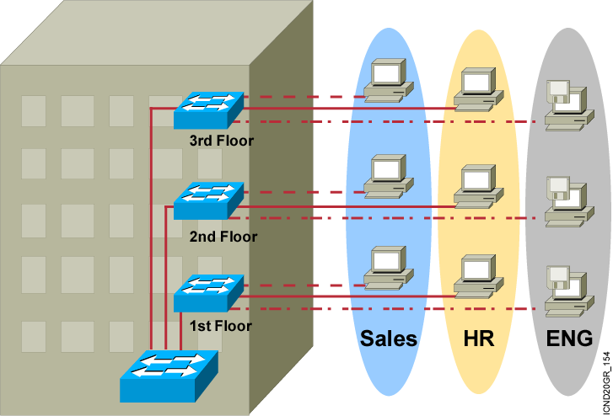
VLAN Overview
  Segmentation
  Flexibility
  Security
A VLAN = A Broadcast Domain = Logical Network (Subnet)
Notes:
Purpose:
Emphasize: A VLAN is a broadcast domain.
Note: In order to have inter-VLAN communications, a router is required.

Slide 7
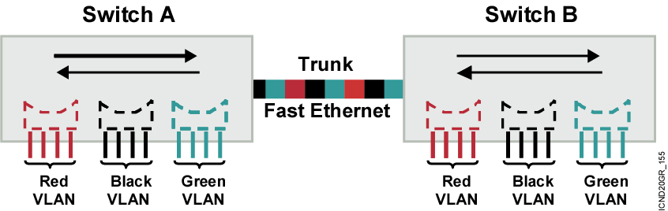
VLAN Operation
Each logical VLAN is like a separate physical bridge.
VLANs can span across multiple switches.
Trunks carry traffic for multiple VLANs.
Trunks use special encapsulation to distinguish between different VLANs.
Notes:
Layer 3 of 3
Emphasize: A trunk is used to connect two switches together.
A trunk carries traffic for multiple VLANs.
Only the Fast Ethernet ports on the 1900 can be configured as trunk port.
Trunking is off by default on the 1900 Fast Ethernet ports (fa 0/26 and fa 0/27).
Note: The 1900 supports DISL.
At the time of the beta, the core switch (2900xl) doesn’t support DISL.

Slide 8
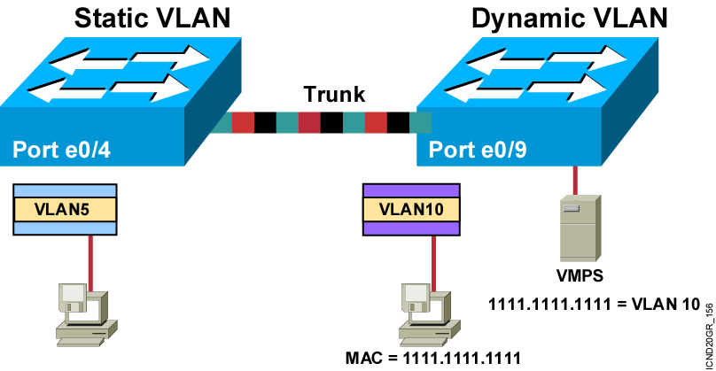
VLAN Membership Modes
Notes:
Note: Once a port has been assigned to a VLAN, it cannot send or receive traffic from devices in another VLAN without the intervention of a Layer 3 device like a router.
The 1900 can’t be configure as the VMPS.
A CiscoWorks 2000 or CWSI management station or a Catalyst 5000 switch can be configured as the VMPS.
In the future, dynamic VLANs may also offer membership based on other criteria such as protocol or application. Dynamic VLANs are covered in the Managing Cisco Switched Internetworks class.

Slide 9
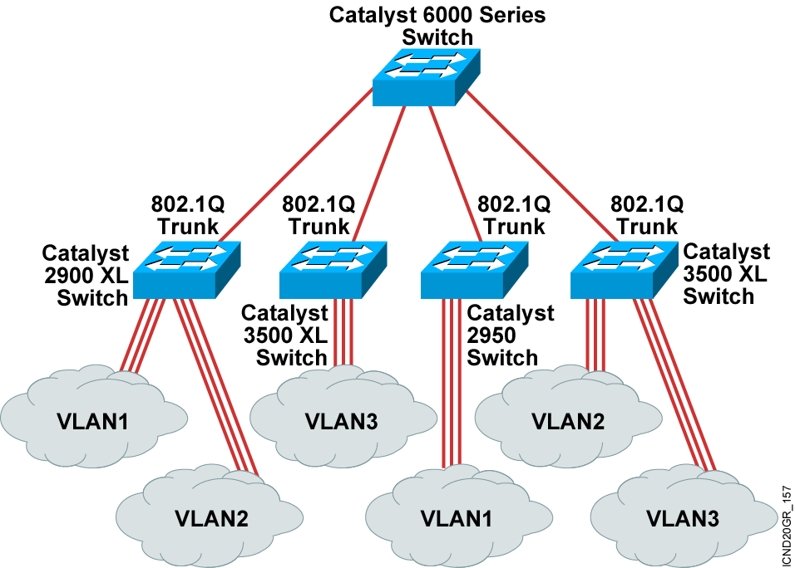
802.1Q Trunking

Slide 10
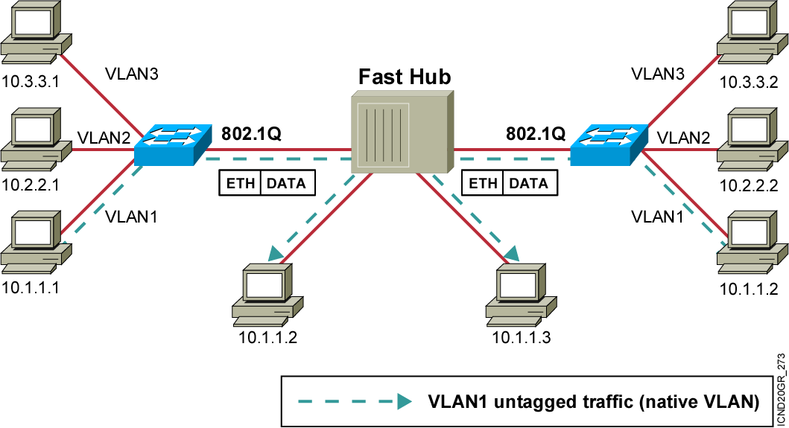
Importance of Native VLANs

Slide 11
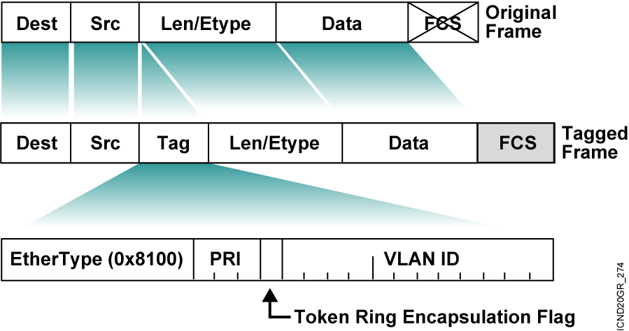
802.1Q Frame

Slide 12
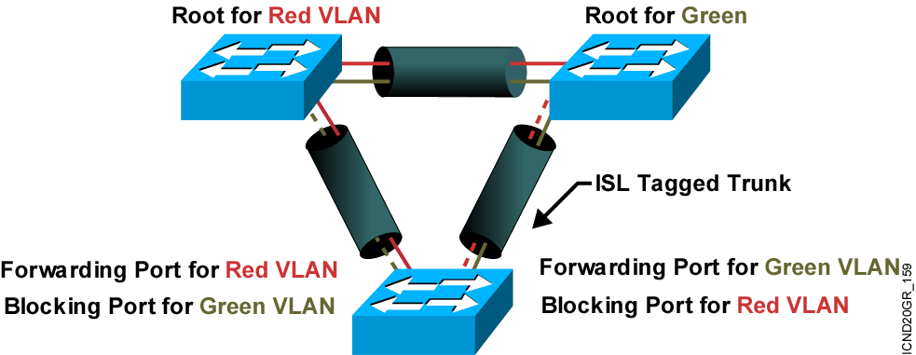
Per-VLAN Spanning Tree

Slide 13
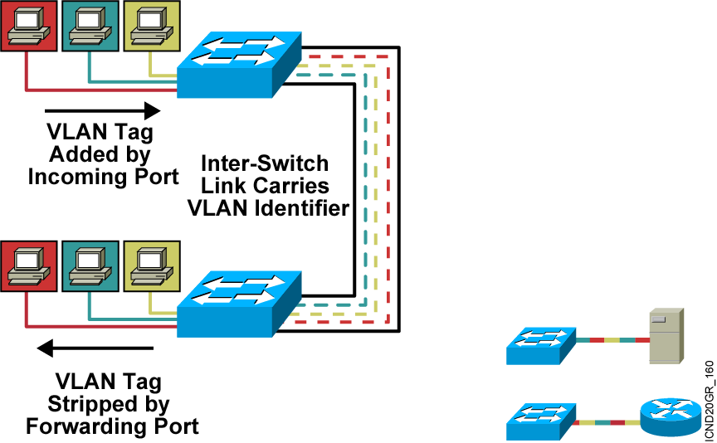
ISL Tagging
ISL trunks enable VLANs across a backbone.
  Performed with ASIC
  Not intrusive to client stations; ISL header not seen by client
  Effective between switches, and between routers and switches
Notes:
Note: The 1900 only supports ISL trunking.
ISL is Cisco proprietary. 802.1Q is an IEEE standard.
Other trunk types:
LANE (VLANSs over ATM)
802.10 (FDDI trunk)

Slide 14
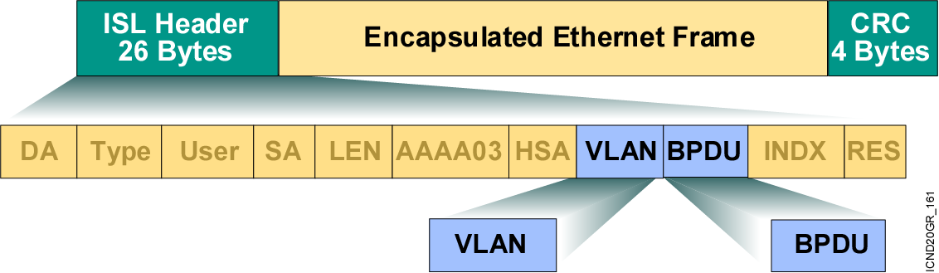
ISL Encapsulation

Slide 15
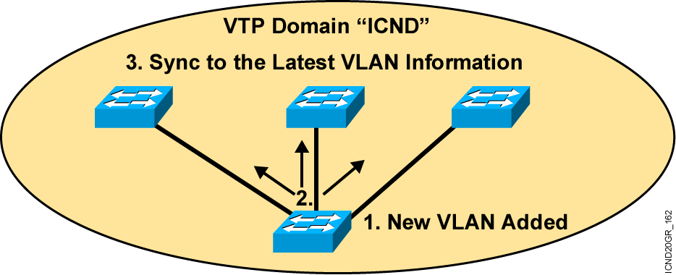
VTP Protocol Features
  A messaging system that advertises VLAN configuration information
  Maintains VLAN configuration consistency throughout a common administrative domain
  Sends advertisements on trunk ports only
Notes:
Notes: VTP is a Cisco proprietary feature. VTP is a Layer 2 messaging protocol that maintains VLAN configuration consistency by managing the addition, deletion, and renaming of VLANs on a network-wide basis. VTP minimizes misconfigurations and configuration inconsistencies that can cause several problems, such as duplicate VLAN names, incorrect VLAN-type specifications, and security violations.
A VTP domain (also called a VLAN management domain) is one switch or several interconnected switches sharing the same VTP domain. A switch is configured to be in only one VTP domain. You make global VLAN configuration changes for the domain by using the Cisco IOS command-line interface (CLI), Cisco Visual Switch Manager Software, or Simple Network Management Protocol (SNMP).
By default, a 1900 switch is in the no-management-domain state until it receives an advertisement for a domain over a trunk link or you configure a management domain.
The default VTP mode is server mode, but VLANs are not propagated over the network until a management domain name is specified or learned. If the switch receives a VTP advertisement over a trunk link, it inherits the management domain name and configuration revision number. The switch then ignores advertisements with a different management domain name or an earlier configuration revision number.
When you make a change to the VLAN configuration on a VTP server, the change is propagated to all switches in the VTP domain. VTP advertisements are transmitted out all trunk connections, including Inter-Switch Link (ISL), IEEE 802.1Q, IEEE 802.10, and ATM LAN Emulation (LANE).
If you configure a switch from VTP transparent mode, you can create and modify VLANs, but the changes are not transmitted to other switches in the domain, and they affect only the individual switch.

Slide 16
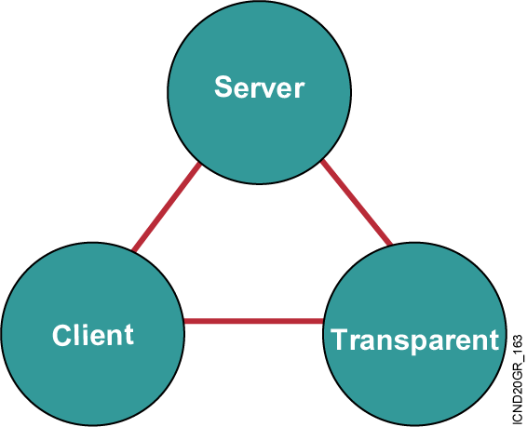
VTP Modes
Creates VLANs
Modifies VLANs
Deletes VLANs
Sends/forwards
advertisements
Synchronizes
Saved in NVRAM
Creates VLANs
Modifies VLANs
Deletes VLANs
Forwards
advertisements
Does not
synchronize
Saved in NVRAM
Forwards
advertisements
Synchronizes
Not saved in
NVRAM
Notes:
Emphasize: Default VTP mode on the Catalyst switches is server. Be careful when adding new switches into an existing network. This is covered in more detail later.

Slide 17
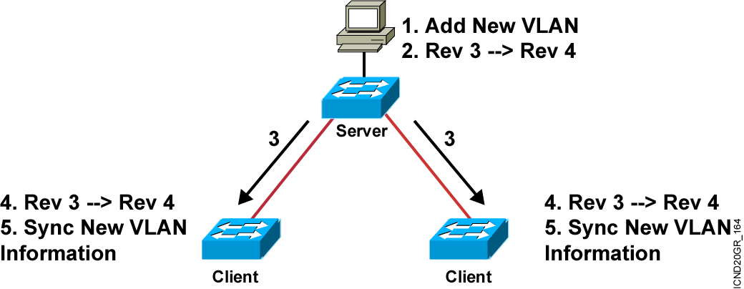
VTP Operation
  VTP advertisements are sent as multicast frames.
  VTP servers and clients are synchronized to the latest revision number.
  VTP advertisements are sent every 5 minutes or when there is a change.
Notes:
Layer 2 of 2
Emphasize: The latest revision number is what the switches will synchronize to.

Slide 18
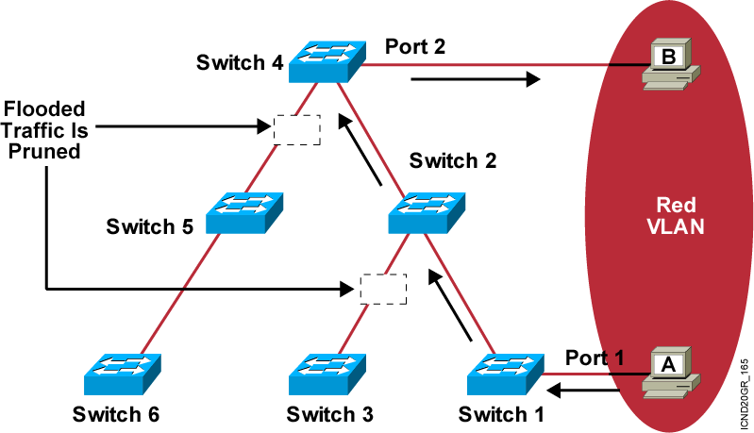
VTP Pruning
  Increases available bandwidth by reducing unnecessary flooded traffic
  Example: Station A sends broadcast, and broadcast is flooded only toward any switch with ports assigned to the red VLAN
Notes:
Emphasize: VTP prunning provides optimized flooding. Without VTP prunning, station A’s broadcast will be flooded to all switches whether they have any port in the red VLAN or not.
Note: VLAN1 can’t be prunned. STP, CDP, VTP updates are sent on VLAN1.
All switches in the switched network must support prunning or prunning will be disabled.
Each trunk port maintains a state variable per VLAN indicating if the switch has any port assigned to a particular VLAN or not.

Slide 19
Summary
  A VLAN permits a group of users to share a common broadcast domain regardless of their physical location in the internetwork. VLAN improve performance and security in switched networks.
  A Catalyst switch operates in a network like a traditional bridge. Each VLAN configured on the switch implements address learning, forwarding/filtering decisions, and loop avoidance mechanisms.
  Ports belonging to a VLAN are configured with a membership mode that determines to which VLAN they belong. Catalyst switches support two VLAN membership modes: static and dynamic.
  The IEEE 802.1Q protocol is used to transport frames for multiple VLANs between switches and routers, and for defining VLAN topologies.
Notes:
Purpose: This slide discuss the initial configurations on the routers and switches.
Note: There is no setup mode on the Catalyst 1900 switch.

Slide 20
Summary (Cont.)
  ISL is a Cisco proprietary protocol to transport multiple VLANs between switches and routers. ISL provides VLAN tagging capabilities while maintaining full wire-speed performance.
  VTP is a protocol used to distribute and synchronize identifying information about VLANs configured throughout a switched network. VTP allows switched network solutions to scale to large sizes by reducing the manual configuration required on each switch in the network.
  VTP operates in one of three modes: server, client, or transparent. The default VTP mode is server mode, but VLANs are not propagated over the network until a management domain name is specified or learned.

Slide 21


